Slide 1
Operators and Expressions
Dr. Neeraj Kumar Pandey

Slide 2
Introduction
C# supports a rich set of operators. C# Operators can be classified into a number of related categories as below:-
Arithmetic
Relational
Logical
Assignment
Increment and Decrement
Conditional
Bitwise
Special

Slide 3
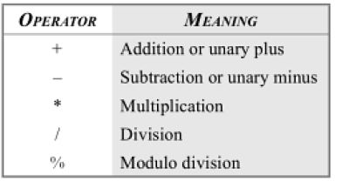
Arithmetic Operators

Slide 4
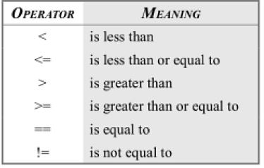
Relational Operators

Slide 5
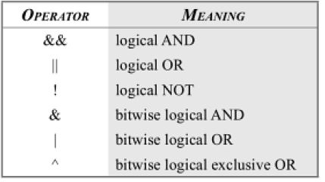
Logical Operators

Slide 6
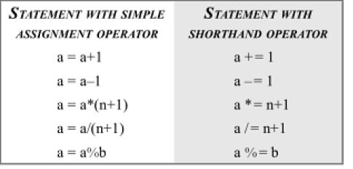
Assignment Operator

Slide 7
Increment and Decrement Operator
using System;
class incdecop
{
public static void Main()
{
int x=10,y=30;
Console.WriteLine(“x= “ +x);
Console.WriteLine(“y= “ +y);
Console.WriteLine(“++x= “ ++x);
Console.WriteLine(“++y= “ ++y);
Console.WriteLine(“x++= “ x++);
Console.WriteLine(“y++= “ y++);
Console.WriteLine(“x= “ -x);
Console.WriteLine(“y= “ -y);
Console.WriteLine(“--x= “ --x);
Console.WriteLine(“--y= “ --y);
Console.WriteLine(“x--= “ x--);
Console.WriteLine(“y--= “ y--);
}
}

Slide 8
Conditional Operators
The character pair ? : is a ternary operator available in C#. This operator is used to construct conditional expression of the form
exp1 ? exp2 : exp3
exp1 is evaluated first. If it is true , then the expression exp2 is evaluated and becomes the value of the conditional expression.
If exp1 is false, exp3 is evaluated and its value becomes the value of the conditional expression.
Note that only one of the expressions is evaluated.
int x=90;
int y=98;
z=(x>y)? x: y;

Slide 9
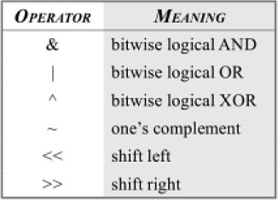
Bitwise Operators

Slide 10
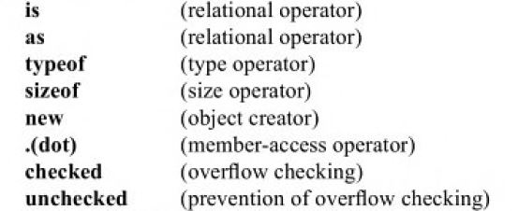
Special Type

Slide 11
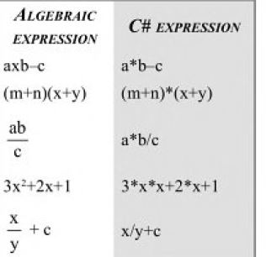
Arithmetic Expression

Slide 12
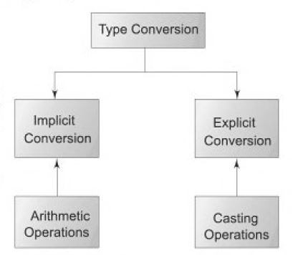
Type Conversion

Slide 13
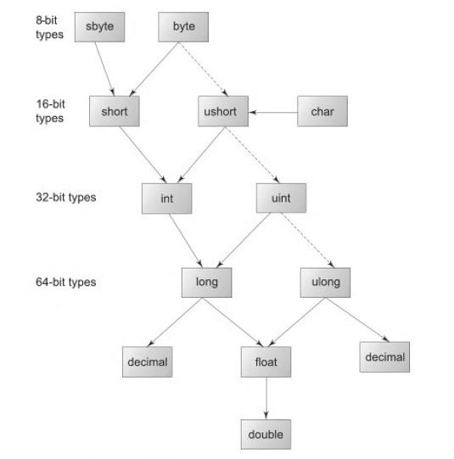
C# Conversion Chart

Slide 14
Explicit Conversion
int to short
int to uinit
uint to int
float to int
decimal to any numeric type
Any numeric type to char
int x= 60;
byte y =(byte)x;

Slide 15
Use of Casting Operation
using System;
class bulb
{
public static void Main()
{
float sum;
int I;
sum=0.0F;
for(i=1; i<=10; i++)
{
sum=sum+1/(float)i;
Console.Write(“ i= “ +i);
Console.WriteLine(“Sum=“ +sum);
}
}
}

